Slide 1

Exploring Renewable Energy Sources
An Overview of Sustainable Solutions

Slide 2

Solar Energy
Include key points about solar energy, such as its definition, benefits, and examples of solar power application.

Slide 3

Wind Energy
Highlight important details about wind energy, including how it works, advantages, and notable wind farms worldwide.
C BY-SA.

Slide 4
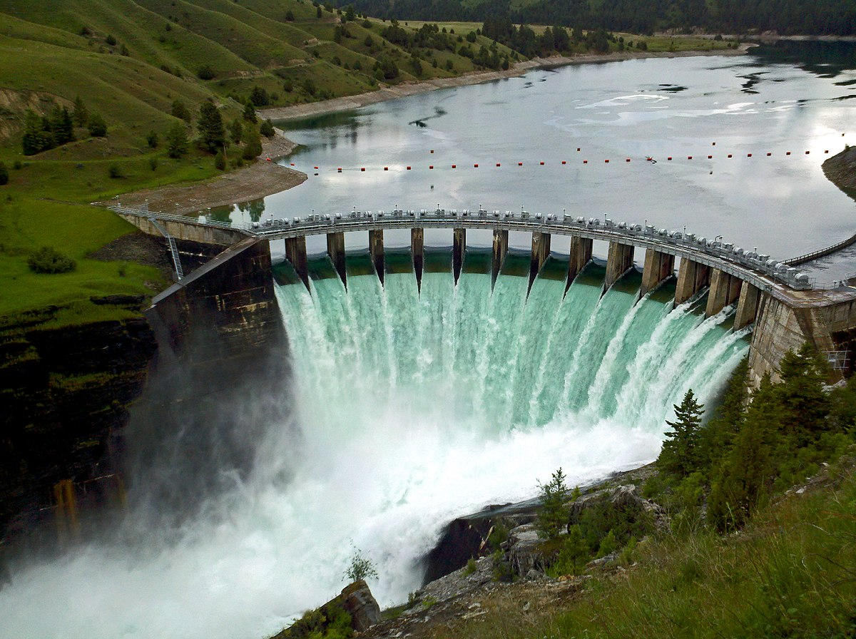
Hydroelectric Power
Present key information about hydroelectric power, including its process, benefits, and notable hydroelectric plants.

Slide 5

Sources
List the sources used to gather information for the presentation, such as books, websites, or research papers.
.

